Slide 1
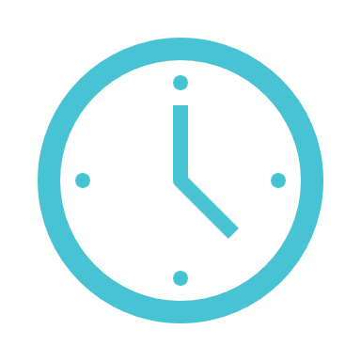
Python Assignment-2
NAME : VAISHNAVI A K
CSIT-B

Slide 2
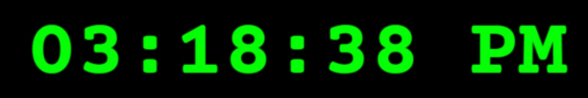
TOPIC: CODING A DIGITAL CLOCK USING PYTHON

Slide 3
INDEX:
CODE INVOLVED
OUTPUT
GRAPHICAL USER INTERFACE
TKINTER
PYTHON TIME MODULE
MODULES OF TKINTER

Slide 4
CODE INVOLVED:
from tkinter import *
from tkinter.ttk import *
from time import strftime
a = Tk()
a.title('Digital Clock')
def time():
string = strftime('%H:%M:%S %p')
lbl.config(text = string)
lbl.after(1000, time)
lbl = Label(a, font = ('calibri', 40, 'bold'),
background = ‘red',
foreground = 'white')
lbl.pack()
time()
mainloop()

Slide 5
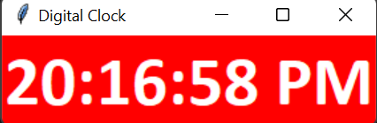
OUTPUT:

Slide 6




IDE:
COMPILER:

Slide 7
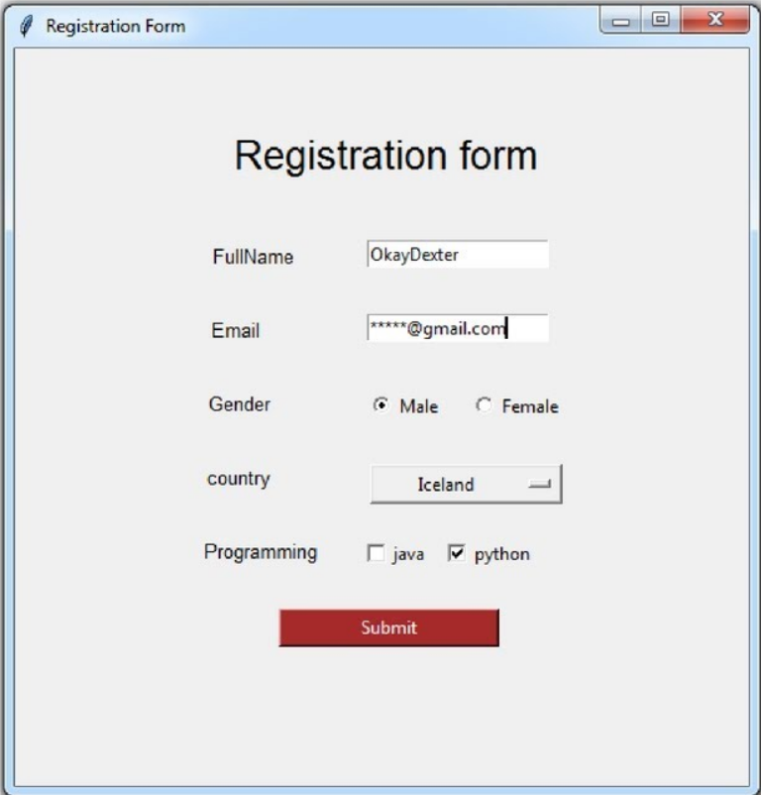
What is GUI?
Graphical User Interface(GUI) is a form of user interface which allows users to interact with computers through visual indicators using items such as icons, menus, windows, etc. It has advantages over the Command Line Interface(CLI) where users interact with computers by writing commands using keyboard only and whose usage is more difficult than GUI.

Slide 8
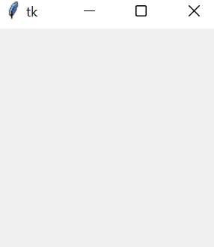
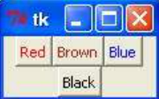
What is tkinter?
Tkinter is a standard GUI Library for Python. -The name Tkinter comes from Tk interface. -It is a module which is used to create GUI applications. -It is free software. -It provides powerful object-oriented interface to Tk GUI toolkit. -It consists of number of widget classes. -Tkinter module contains low-level interface to Tk
-Tk provides various widgets few are: button,label,canvas,frame,text,menu etc..

Slide 9
Python time module:
Python time module allows to work with time in Python. It allows functionality like getting the current time, pausing the Program from executing, etc. So before starting with this module we need to import it.
-to import the time module we use: import time
Strftime():
Python time method strftime() converts a tuple or struct_time representing a time as returned by gmtime() or localtime() to a string as specified by the format argument.
Label:
It refers to the display box where you can put any text or image which can be updated any time as per the code.

Slide 10
.config():
-it is a method used to display text on the GUI window
Syntax: label.config(text)
.after():
-The after() method calls the callback function once after a delay milliseconds (ms) within Tkinter’s main loop
.pack():
-it is a method in tkinter that packs all the widget one after the other
mainloop():
-mainloop in Python Tkinter is an infinite loop of the application window which runs forever so that we can see the still screen.

Slide 11
This presentation has helped me to learn about - time and tkinter module - various methods associated with it

Slide 12

Thank You

